Slide 1

Online Retail Enhancements
Using Data Science to enhance our Online Retail

Slide 2
Introduction to the dataset and the business case
The CEO of the online retail store wants to understand the purchasing behavior of customers and identify patterns that can be leveraged to increase sales and profitability.
Problem to be Solved:
Identify the most popular products and product categories among customers.
Understand the demographics of the customers and their purchasing behavior.
Identify any trends or patterns in sales data.
Determine which customers are the most valuable to the company.
Identify any potential issues or areas for improvement in the company's operations.

Slide 3
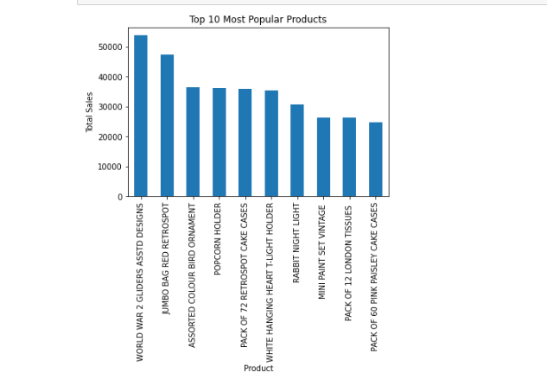
Key findings (e.g. most popular products, customer demographics, sales trends)

Slide 4
Visualizations to support the findings
Line charts: Line charts can be used to show trends over time, such as sales or website traffic. This can help the CEO understand how the business is performing over a period of time and identify any patterns or changes.
Bar charts: Bar charts can be used to compare different categories or groups of data, such as sales by product category or website traffic by source. This can help the CEO identify which products or marketing channels are performing well and which are not.
Pie charts: Pie charts can be used to show the proportion of different categories or groups of data. For example, a pie chart can be used to show the proportion of sales by product category or the proportion of website traffic by source.
Heat maps: Heat maps can be used to show patterns and trends in data across multiple dimensions. For example, a heat map can be used to show the distribution of sales across different products, categories, and regions.

Slide 5
Recommendations for how the company can leverage these findings to increase sales and profitability
Personalization: Use data on customer behavior and preferences to create personalized recommendations and targeted marketing campaigns.
Inventory management: Use data on sales patterns and customer demand to optimize inventory levels and reduce costs.
Pricing strategy: Use data on competitor prices and customer demand to set optimal prices for products.
Product development: Use data on customer needs and preferences to inform product development and design.
Marketing optimization: Use data on the effectiveness of different marketing channels and campaigns to optimize future marketing efforts.
Upselling and cross-selling: Use data on customer behavior and purchase history to identify opportunities for upselling and cross-selling.

Slide 6
Conclusion and next steps
product development, marketing optimization, and upselling and cross-selling, as these areas have the potential to drive the most significant impact on sales and profitability.
The company should use predictive modeling, machine learning, optimization, natural language processing, and recommender systems to analyze data and inform business decisions.
The company should use visualizations to present data in an intuitive and user-friendly format and create dashboards to monitor key performance indicators in real-time.

